Slide 1

HackLboro 2021 Presentation
Team 2: Chomba, Shalom, Matt, Callum and Jonathan

Slide 2
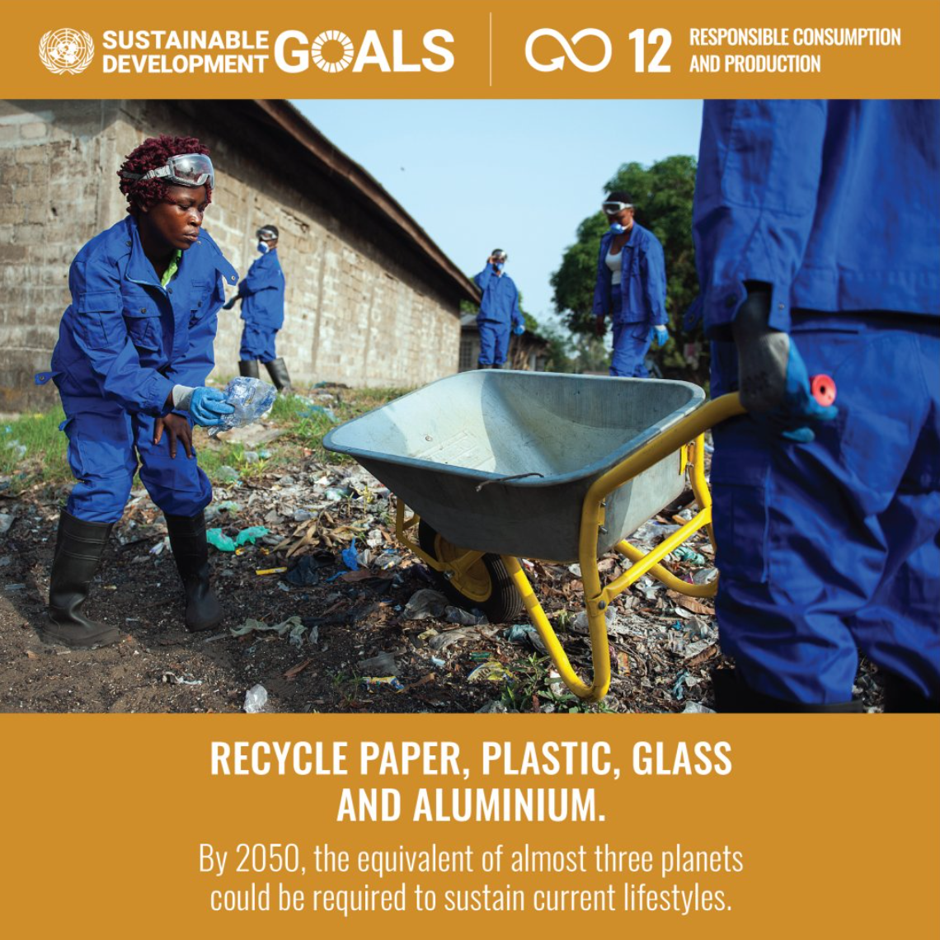
Problem Statement
The Sustainable Development Goals are a collection of 17 interlinked global goals set in 2015 by the United Nations General Assembly.
They are designed to be a “blueprint to achieve a better and more sustainable future for all”.
Our team has focused on ‘Goal 12: Responsible Consumption and Production’.
Target 12.5 – “By 2030, substantially reduce waste generation through prevention, reduction, recycling and reuse.” (1)
Target 12.8 – “By 2030, ensure that people everywhere have the relevant information and awareness for sustainable development and lifestyles in harmony with nature.” (1)

Slide 3
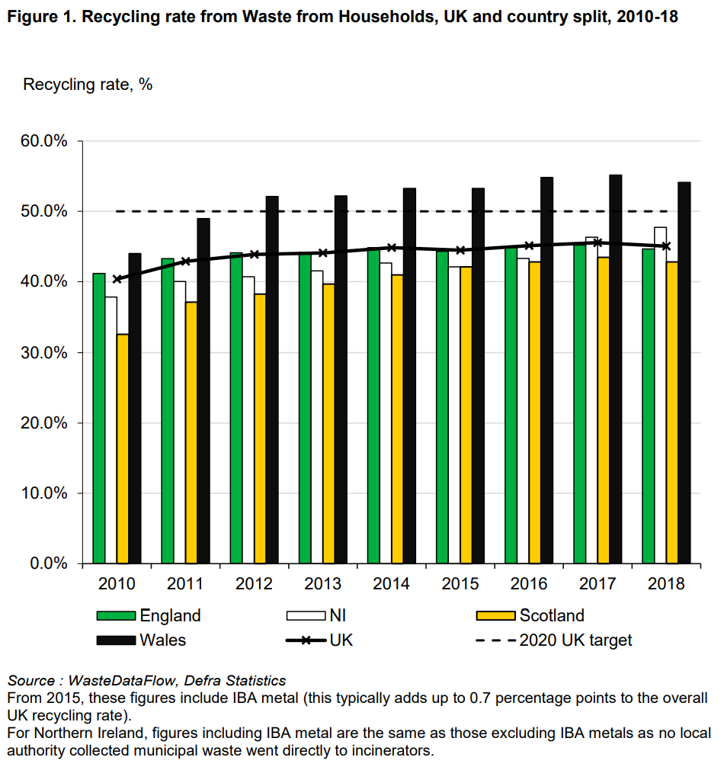
An Overview of Recycling in the UK
The UK recycling rate for Waste from Households (WfH) was 45.0% in 2018. (2)
The UK generated 221.0 million tonnes of total waste in 2016, with England responsible for 85% of the UK total. (2)
As seen in Figure 1, England’s recycling rate has plateaued in recent years. (2)

Slide 4
What is our idea?
A system which advises users on how to be sustainable consumers, focusing on the principles of reduce, reuse, recycle.
Reduce | Reuse | Recycle
Help users identify whether the products they are purchasing are sustainable. | Suggest activities which utilise waste products and materials, particularly aimed at children. | Advise users of the types of waste that can be recycled in their respective districts.
Introduce users to sustainable alternatives to popular products. | Locate nearby charities and inform the user of the products they accept. | Locate nearby recycling centres and inform the user of the types of waste they accept.
Provide links to useful resources which promote sustainable practices. | Offer a platform for users to trade unwanted items.

Slide 5

Example of Use (Part One)
Reduce
Item
Please select an item.
Reuse
District
Automotive
Building Materials
Cardboard
Electricals
Foil
Food Waste
Garden Waste
Glass
Liquids and Chemicals
Recycle

Slide 6
Example of Use (Part Two)
Please select an item.
Grass Cuttings
Please select a district.
Grass Cuttings
Christmas Trees
Flowers
Grass Cuttings
Leaves
Plants
Twigs
District
Adur
Allerdale
Arun
Ashfield
Ashford
Aylesbury Vale
Basildon
Bassetlaw
Bedford
Birmingham City
Bassetlaw
Go!
Go!

Slide 7
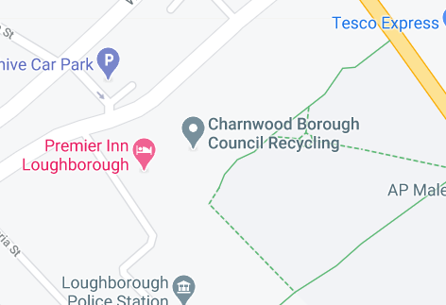
Example of Use (Part Three)
Unfortunately, this item cannot be placed in your recycling bin. Please enter your postcode to be directed to the nearest suitable recycling centre.
Unfortunately, this item cannot be placed in your recycling bin. Please enter your postcode to be directed to the nearest suitable recycling centre.
LE11 1AB
Charnwood Borough Council Recycling
Loughborough Recycling and Household Waste Site (2.1 miles)
Charnwood Borough Council Recycling (3.6 miles)
Postcode
LE11 1AB
Automotive
Building Materials
Cardboard
Electricals
Foil

Slide 8
References
https://sdgs.un.org/goals/goal12
https://assets.publishing.service.gov.uk/government/uploads/system/uploads/attachment_data/file/918270/UK_Statistics_on_Waste_statistical_notice_March_2020_accessible_FINAL_updated_size_12.pdf

